Slide 1
FAKE CURRENCY DETECTION

Slide 2
TEAM MEMBERS
2110030009-G.Vaishnavi
2110030028-P.Praneeth
2110030147-G.Mahitha
2110030020-Ch.Sri Chandana

Slide 3
Problem Statement
The Advancement in color printing technology has increased the making of fake currency notes and making of duplicate notes on a large scale.
In the past few years printing was done in the printing house, but now anyone has a printer at home and can print fake notes with maximum accuracy.
This results in the issue of fake currency instead of real currency found in our market.
The issues of fake currency are evident in daily reports of fake currency frauds.
The enhancement in technology like computers, scanners, and copies has made it much easier to create fake currency and there is no software to detect fake or real currency.
This problem leads to the creation of fake currency in less time and more efficiently.

Slide 4
OBJECTIVE
So to overcome this problem we design a system that can classify the currency into real or fake currency.
There are machines available in banks and other markets to check financial authenticity.
But the common man does not check each note whether fake or real.
Therefore the need for software to obtain fake money arises, which can be used by ordinary people.
This proposed system uses image processing to determine if the currency is fake or real.
The program is designed entirely using Python language. Contains steps such as grayscale conversion, edge detection, splitting, etc.

Slide 5
Literature survey
Mayadevi A. Gaikwad, Vaijinath V. Bhosle Vaibhav D Patil. In their research paper, they suggested a methodology for detecting fake currency from the real by comparing their visual features such as the distance between Gandhiji’s portrait and other notations. This methodology can be useful for a system purely based on software processing.
Renuka Nagpure, Shreya Shetty, Trupti Ghotkar. They have proposed a system that uses the floral designs on the notes provided by RBI to distinguish between real and fake notes.
Neeru Rathee ,Arun Kadian, Rajat Sachdeva ,Vijul Dalel, Yatin Jaie. In their paper, they have suggested image processing along with supervised machine learning to learn the distinguishing feature of a real note from a fake one which will increase the precision of this method.

Slide 6
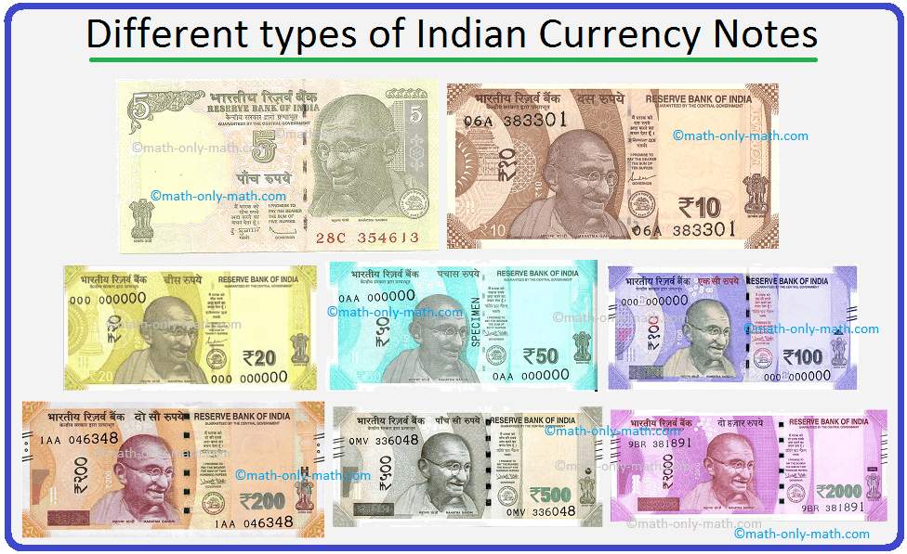
DATASET COLLECTION
This Dataset contains 195 images of 8 categories of Indian Currency Notes.
This data is collected from Google images, and Shutter-stock images respectively, you can Play with this Dataset, to recognize types of Indian notes, from the Photo, or Real-Time Applications.
This Dataset looks forward, as Image Classification Data, which contains 8 Distinct types of Indian Currency Notes, the images are not reduced to any single size, they may have different proportions.

Slide 7


Tools Required
Hardware Requirements:
Processor: Intel Core i3 or more.
RAM: 4GB or more.
Hard disk: 250 GB or more.
Software Requirements:
Operating System
PyCharm
Flask
MySQL

Slide 8
METHODOLOGY
Image Acquisition: The image is provided to the model. There should be two images – a note which you want to detect and a corresponding real note.
RGB to GRAYSCALE: The RGB image is converted into a GRAYSCALE image.
Segmentation: The image is segmented to crop Gandhi Ji image and thin strip image.
Feature Measurement: Feature measurement is done to measure the number of lines on a thin strip. This is a really lengthy process.
Finding Correlation: We find a correlation between Gandhi Ji’s image on the original note and a fake note. If the result is greater than 0.5 then we will consider it legitimate otherwise the currency is fake.
Classification: Finally, we will classify the image as real or fake.

Slide 9
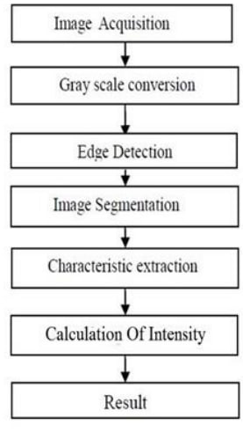
FLOW CHART

Slide 10
IMAGE ACQUISITION:- It can be defined as the act of procuring an image from sources. This can be done via hardware systems such as cameras, encoders, sensors, etc.
GRAY SCALE CONVERSION:-The acquired image is obtained as RGB image which is now converted into gray scale image since it carries intensity information. This image is further processed and edges of gray scale images are detected.
IMAGE SEGMENTATION:-It’s the process of dividing image into multiple parts by cropping it
CHARACTERISTIC EXTRACTION:-The features are extracted using edge based segmentation.
CALCULATION OF INTENSITY:-If the calculated intensity is greater than the threshold of 70%, then it is classified as original note otherwise it is considered as fake one.

Slide 11
Future work
This proposed system uses image processing to determine if the currency is fake or real.
The program is designed entirely using Python language.
Contains steps such as grayscale conversion, edge detection, splitting, etc. which are made using appropriate methods.
The proposed system has advantages such as simplicity and high performance.
The result will predict whether the currency note is fake or not.

Slide 12
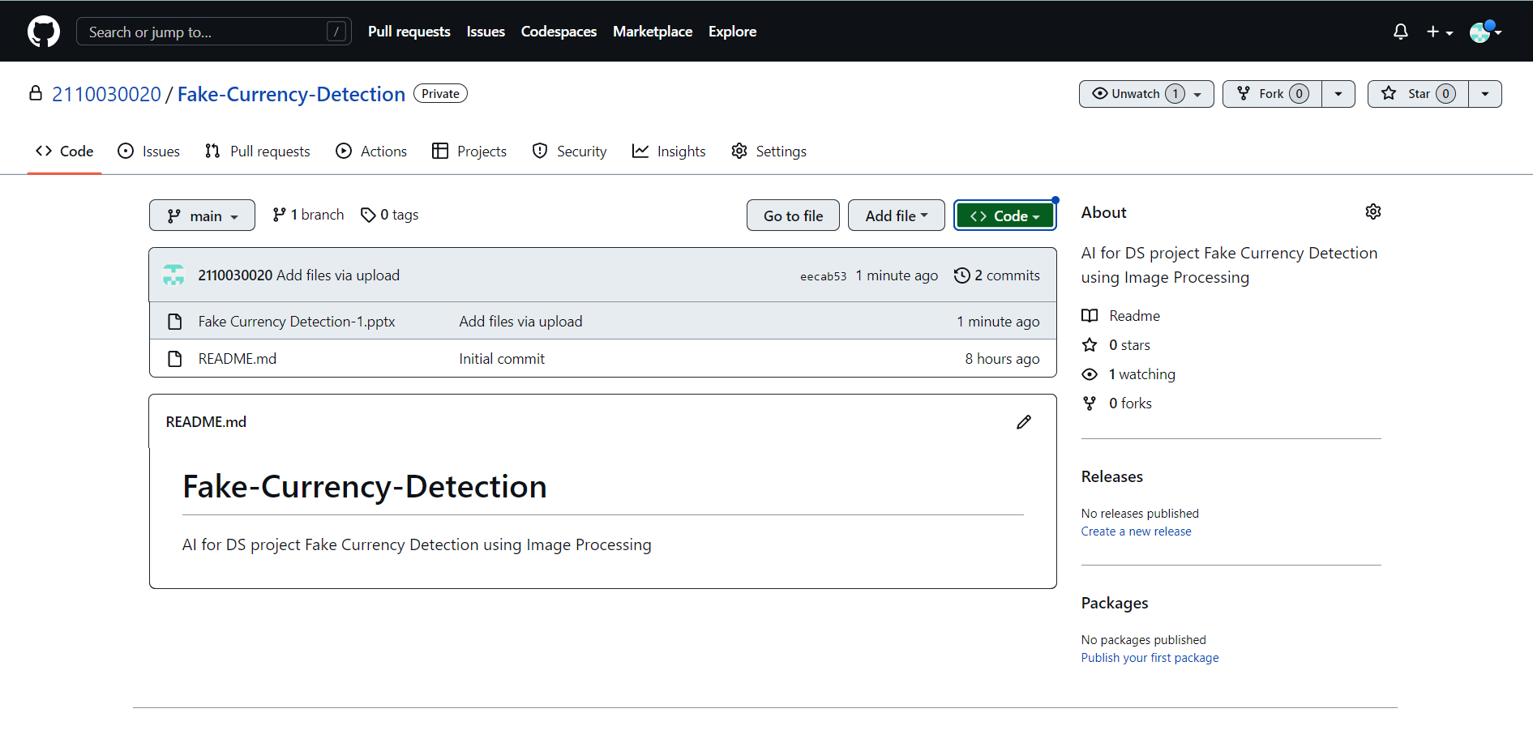
GITHUB repository
Git Hub Link: https://github.com/2110030020/Fake-Currency-Detection.

Slide 13
THANK YOU

